Slide 1
Citing Resources Using APA Formatting
Notes:
1

Slide 2
REFERENCES: APA Citations
When you use information from someone else, you must give that person or company the credit, and acknowledge this was not your original thought:
Author last name, F.I. (date). Title of article or book. Retrieved from URL of website

Slide 3
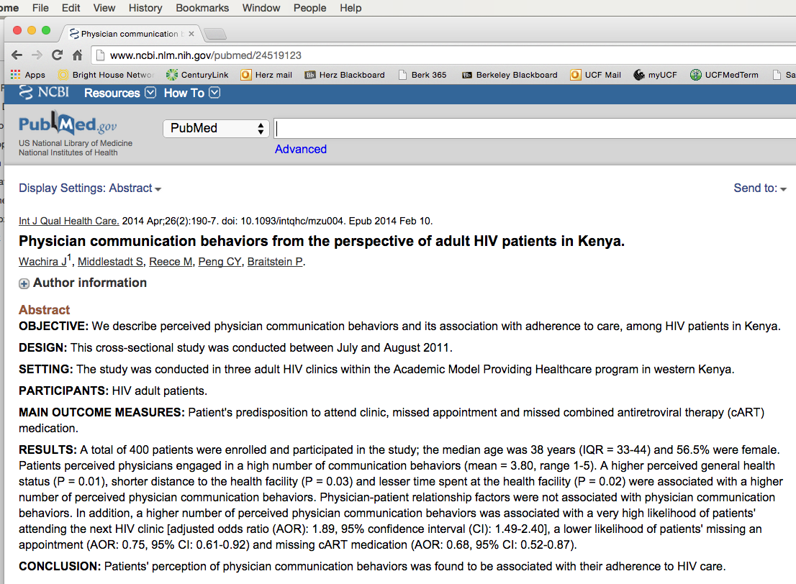
URL
URL
Publication
DATE
AUTHORS
TITLE
AUTHORS
Notes:
Miller, N. (2014, November 17) Shepherd’s Hope’s clinics shift to electronic health records. Retrieved from http://www.orlandosentinel.com/os-shepherds-hope-EHR-20141114-story.html

Slide 4
Parts of the Citation
Author: Last name, First Initial… Wachira, J., Middlestadt, S., Reece, M., Pang, C.Y., & Braitstein, P.
Date Written: Year, Month Day … (2014, April)
Title: Initial capital only … Physician communication behavior from the perspective of adult HIV patients in Kenya.
Publication Title: Volume (Issue) … International Journal of Quality Health Care: 26(4);
Retrieved from: Complete URL … http://www.ncbi.nlm.nih.gov/pubmed24519123

Slide 5
Put The Citation Together
Wachira, J., Middlestadt, S., Reece, M., Pang, C.Y., & Braitstein, P. (2014, April). Physician communication behavior from the perspective of adult HIV patients in Kenya. International Journal of Quality Health Care: 26(4); Retrieved from: http://www.ncbi.nlm.nih.gov/pubmed24519123

Slide 6
Any Questions???
Please contact the Academic Support Center.

